Slide 1


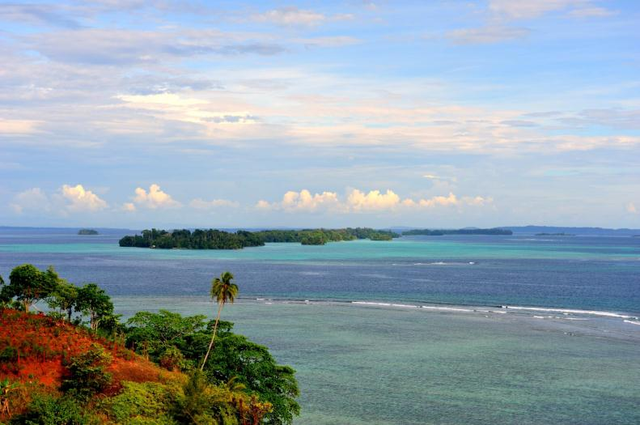

Slide 2
The Call
From FP7 Work Programme 2012/Cooperation/Theme 8:
Socio-economic Sciences and Humanities, pp 28-29.
SSH.2012.2.2-4. Climate change uncertainties: policymaking for the Pacific front
Pacific Island Countries are not directly responsible for climate change
Climate Change is critical
ECOPAS attempts to go beyond the topics usually raised in planning development aid.
Climate change has negative impact on the livelihoods of Pacific people, infrastructure, agriculture, food and housing availability and access to land and water resources
Climate Change can exacerbate tensions around scarcer resources and affect food security
European researchers on the Pacific are poorly coordinated and insufficiently linked to policymaking

Slide 3
The Call
From FP7 Work Programme 2012/Cooperation/Theme 8:
Socio-economic Sciences and Humanities, pp 28-29.
SSH.2012.2.2-4. Climate change uncertainties: policymaking for the Pacific front
Network of European researchers including European and non-European researchers from the Pacific and the Overseas Territories in the region to:
Take stock of ongoing research on the impact of climate change on the Pacific Islands, and other small island states sharing similar problems
Support EU policy-making work on the links between climate change and security-stability-conflict prevention issues, migration, governance, access to resources and economic development, to define better options for sustainable development;
Help to address key policy coherence issues (such as combining Official Development Assistance and non-Official Development Assistance funds, ways to support EU Member States and other partners to define the Pacific as a ‘climate change global priority’);
Analyse adaptation of international funding instruments to the Pacific context and priorities;
Make recommendations on strategies to involve Pacific and EU non-state actors, local authorities, parliaments and the private sector in addressing climate change;
Define a relevant and forward-looking social sciences and humanities research policy agenda for the Pacific region.

Slide 4
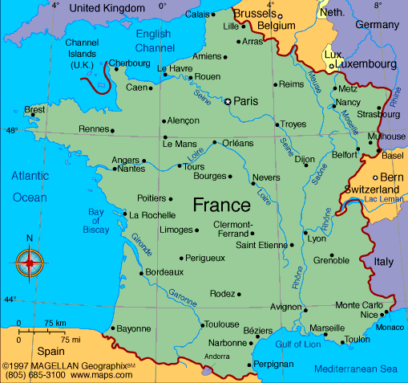
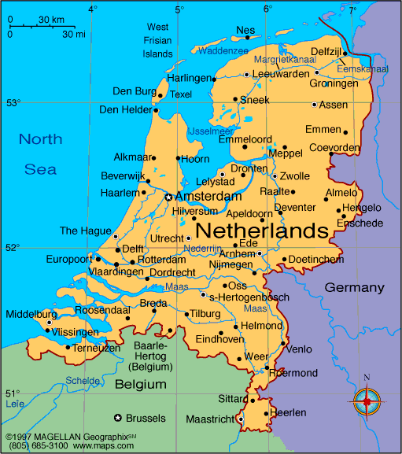
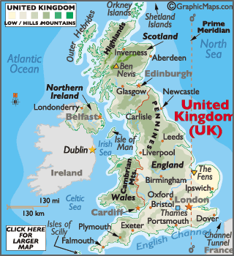
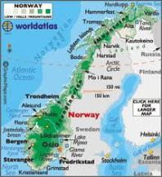

Slide 5
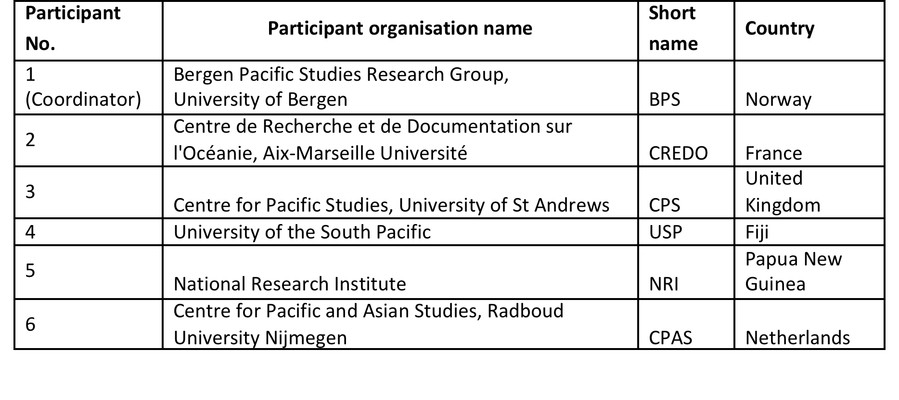
ECOPAS Participants

Slide 6
ECOPAS: Work Package Overview
WP 1: MANAGEMENT AND COORDINATION (BPS) / Objective: Creating a consortium based on a network of European researchers and include European and non-European researchers from the Pacific and Overseas Territories
WP 2: RESOURCE SHARING AND DATABASE BUILDING (CREDO) / Objective: Take stock of on-going research on the impact of climate change on the Pacific Islands and in a comparative perspective.
WP 3: KNOWLEDGE EXCHANGE: RESEARCH POLICY INTERFACES FOR THE PACIFIC CONTEXT (CPS) / Objective: Support EU policy making so as to define better options for sustainable development, with regard to links between climate change and Security- stability-conflict prevention issues as well as between climate change and migration, governance, access to resources and economic development.
.

Slide 7
ECOPAS: Work Package Overview
WP 4: PACIFIC CONTEXTS: COOPERATION AND CAPACITY BUILDING (USP) / Objective: Develop an operative platform between Pacific institutions in the member countries of the USP for knowledge exchange, capacity building and awareness programs in reference to the broad cultural, social and political aspects of climate change and policymaking.
WP 5: STRATEGIES FOR PACIFIC STATE AND NON-STATE INVOLVEMENT (NRI) / Objective: Make recommendations on strategies to involve Pacific non-state actors, local authorities, parliaments and the private sector in addressing climate change
WP 6: EUROPEAN RESEARCHER NETWORKS AND MAJOR THEMATIC CONFERENCE (CPAS) / Objective: Address ways to support EU member states and other partners to define the Pacific as a “climate change global priority”
WP 7: RESEARCH AGENDA FOR POLICY MAKING (BPS) / Objective: Coordinate and formulate a relevant and forward looking social sciences and humanities research policy agenda for the Pacific region.

Slide 8
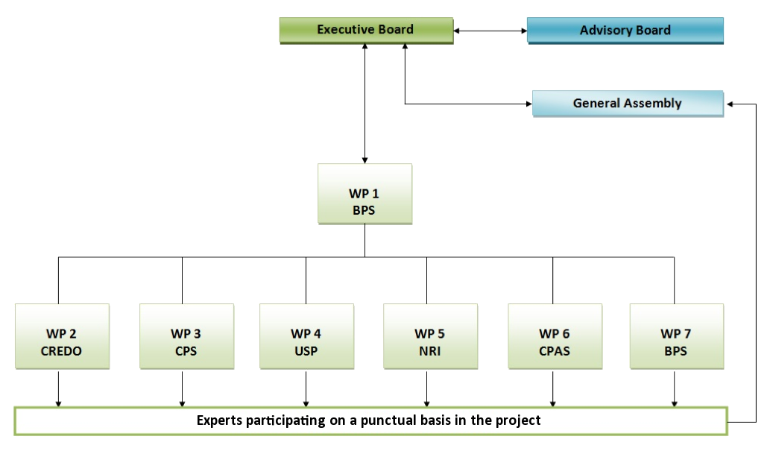

Slide 9
Work Packages
WP1 Management and Project Coordination
WP2 Resource Sharing and Database Building
WP3 Knowledge Exchange: Research Policy Interfaces for the Pacific Context
WP4 Pacific Contexts: Cooperation and Capacity Building
WP5 Strategies for Pacific State and non-State Involvement
WP6 European Research Networks and Major Thematic Conference
WP7 Research Agenda for Policy Making

Slide 10
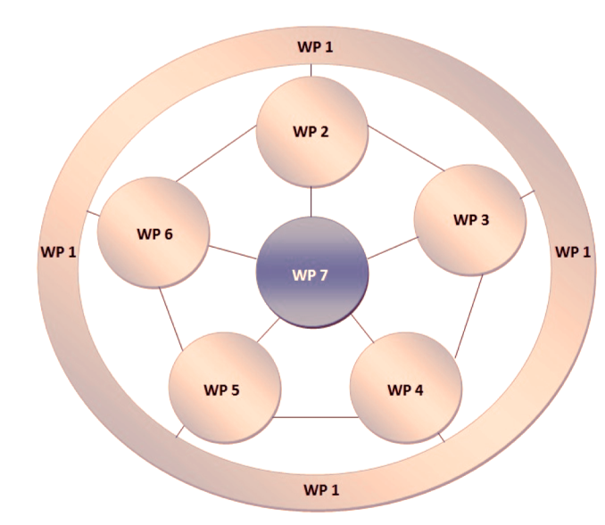

Slide 11
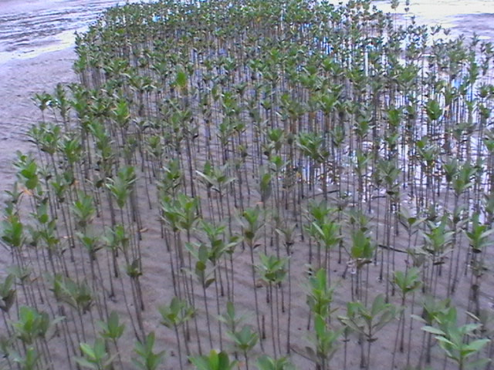
Nukuloa Village

Slide 12
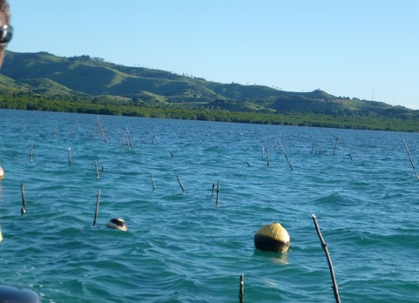
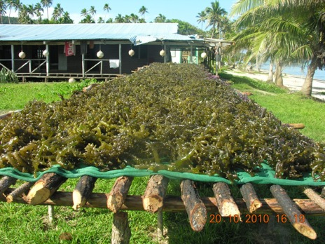
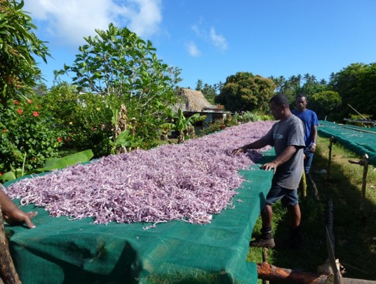
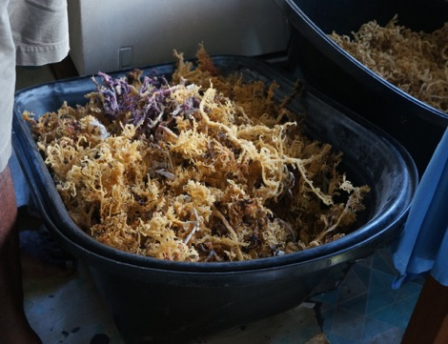

Slide 13
